Slide 1
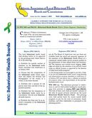
1. Changes to CA Welfare & Institutions Code (WIC) impacting local boards/commissions 2. Changes to Stakeholder Involvement Requirements
Proposition 1 Updates:
Key Changes impacting CA’s Local Mental/Behavioral Health Boards/Commissions
The California Association of Local Behavioral Health Boards/Commissions (CALBHB/C) supports the work of CA’s 59 local mental/behavioral health boards & commissions. www.calbhbc.org

Slide 2
Proposition 1: BHSA
Updates for local mental/behavioral health boards/commissions
WIC Update – Effective January 1, 2025
Membership rosters and bylaws should be updated to reflect changes from Proposition 1 (the Behavioral Health Services Act). Summary of changes:
Youth Membership Requirement: 5604. (2)(B)(i) Fifty percent of the board membership shall be consumers, or the parents, spouses, siblings, or adult children of consumers, who are receiving or have received behavioral health services. One of these members shall be an individual who is 25 years of age or younger. (ii) At least 20 percent of the total membership shall be consumers, and at least 20 percent shall be families of consumers.
Local Education Agency Membership Requirement: 5604. (2)(D) (i) At least one member of the board shall be an employee of a local education agency. (ii) To comply with clause (i), a county shall notify its county office of education about vacancies on the board.
"Mental" is changed to "Behavioral“ and advising regarding "substance use disorder" is added within the duties.

Slide 3
CA Welfare & Institutions Code (WIC) Updates
CA WIC: ​​5600 - 5623 5650-5667 5963.03
WIC for local BH Boards/Commissions
take effect January 1, 2025
Webpage: www.calbhbc.org/legislation-mhb-wic
Document: WIC PDF

Slide 4
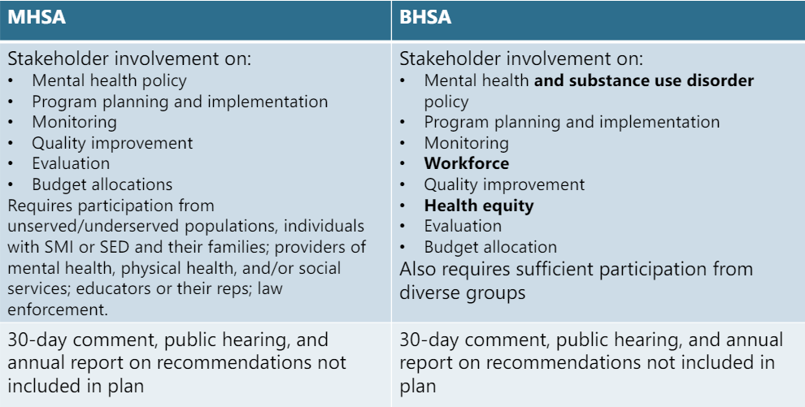
Proposition 1: Local Stakeholder Involvement
BHSA “Integrated Plan” Changes

Slide 5
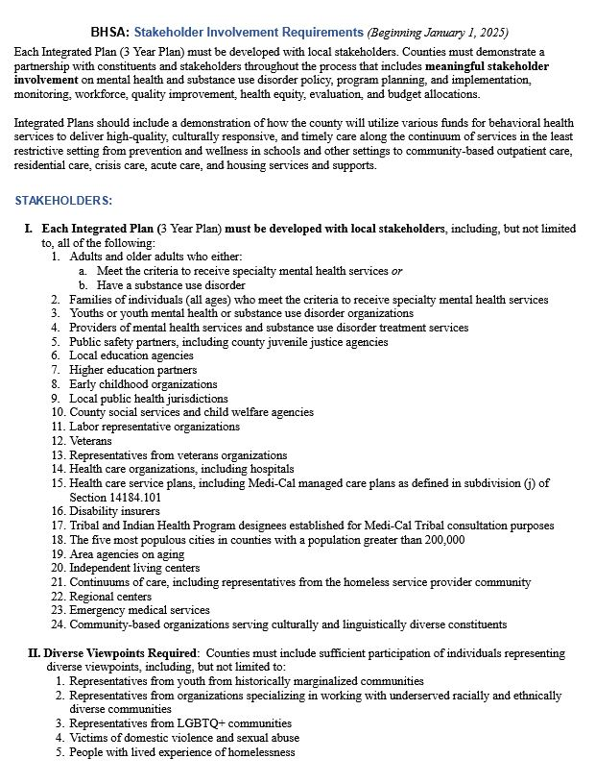
BHSA: Stakeholder Involvement Requirements
(2-Page Document)
BHSA Stakeholder Involvement Requirements
take effect January 1, 2025
www.calbhbc.org/bhsasir

Slide 6
Additional Resources:
Bylaws (Sample) (Google Doc) (Word) (PDF)
Membership Guide (Sample)
www.calbhbc.org/templatessample-docs

Slide 7
Thank You!
Thank you to everyone who serves on or
supports the work of California’s 59 local mental/behavioral health boards/commissions!
CA Association of Local Behavioral Health Boards and Commissions, CALBHB/C
www.calbhbc.org

